Slide 1
HESC Morphogenesis
By Agnes Resto Irizarry
By Agnes M Resto Irizarry
CMPLXSYS 530
04/09/2019

Slide 2
Background and Motivation
Human embryonic stem cells (hESCs) can be used for understanding human embryo development and generating cell replacement therapies
Traditionally used animal models suffer from inadequate translation to humans
Use of fertilized human embryos is controversial
hESCs can be used to create in vivo like structures that help to study specific developmental events
ABMs can be used to test hypothesis regarding the mechanisms at play in hESC morphogenesis

Slide 3
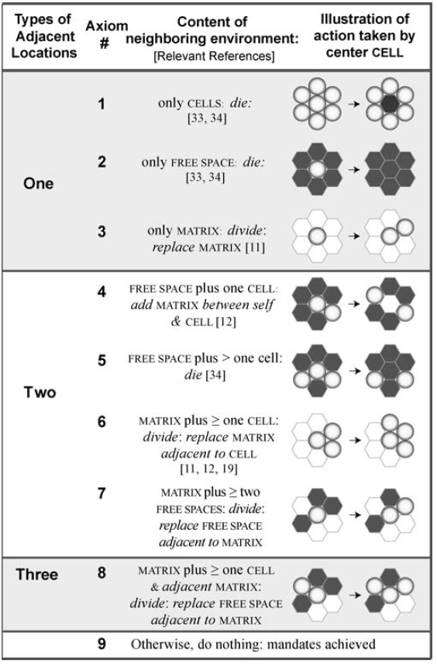
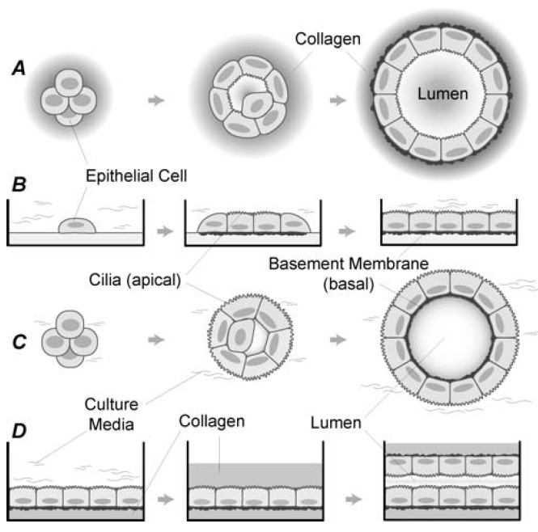
Background and motivation
Epithelial cell (EC) morphogenesis
Rules based on the need of EC cells to establish different surface contacts
Grant et al. PLoS Computational Biology. 2006

Slide 4
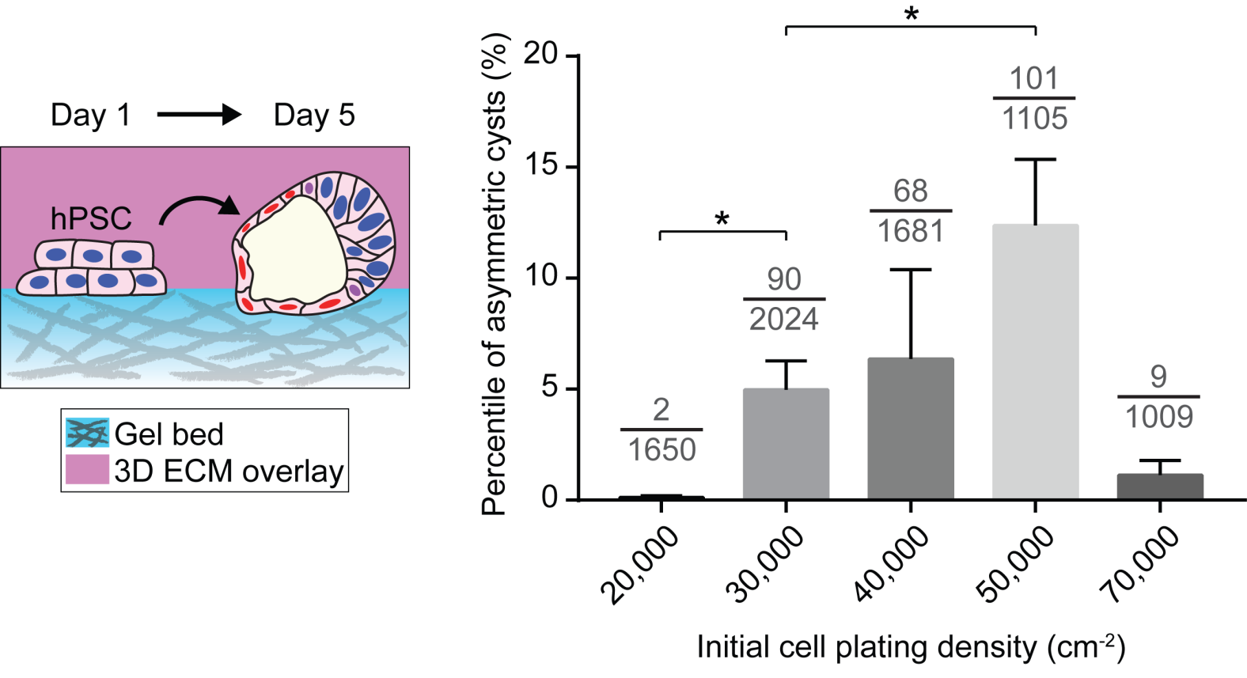
Background and Motivation
Post-implantation amniotic sac embryoid (PASE)
Yue et al. Nature Communications. 2017

Slide 5
Model Design: Agents
Attributes:
neighborhood
number of maximum divisions
time in contact with matrix
time in contact with differentiated cells
differentiated/pluripotent
Methods:
divide
die
move
polarize
produce matrix

Slide 6
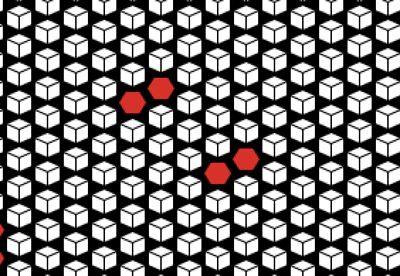
Model Design: Environment
Environment contains matrix
Cells and matrix are constrained to a hexagonal grid

Slide 7
Model Design: Setup and Schedule
User input: initial number of cells in the system/cluster size, maximum number of divisions per cell, differentiation rules
Schedule:
Cells check their state with regards to differentiation
Cells check their neighbors and take an action (die, move, divide, consume matrix)
Cells update their neighborhood
If the system has reached steady state:
Patches establish their neighborhood
Lumen is created in the cavities of cysts
Walkers are created and give unique IDs to lumen
Lumen pass on their IDs to the cells in the cyst
If all the cells in the system have group-ids the model stops

Slide 8
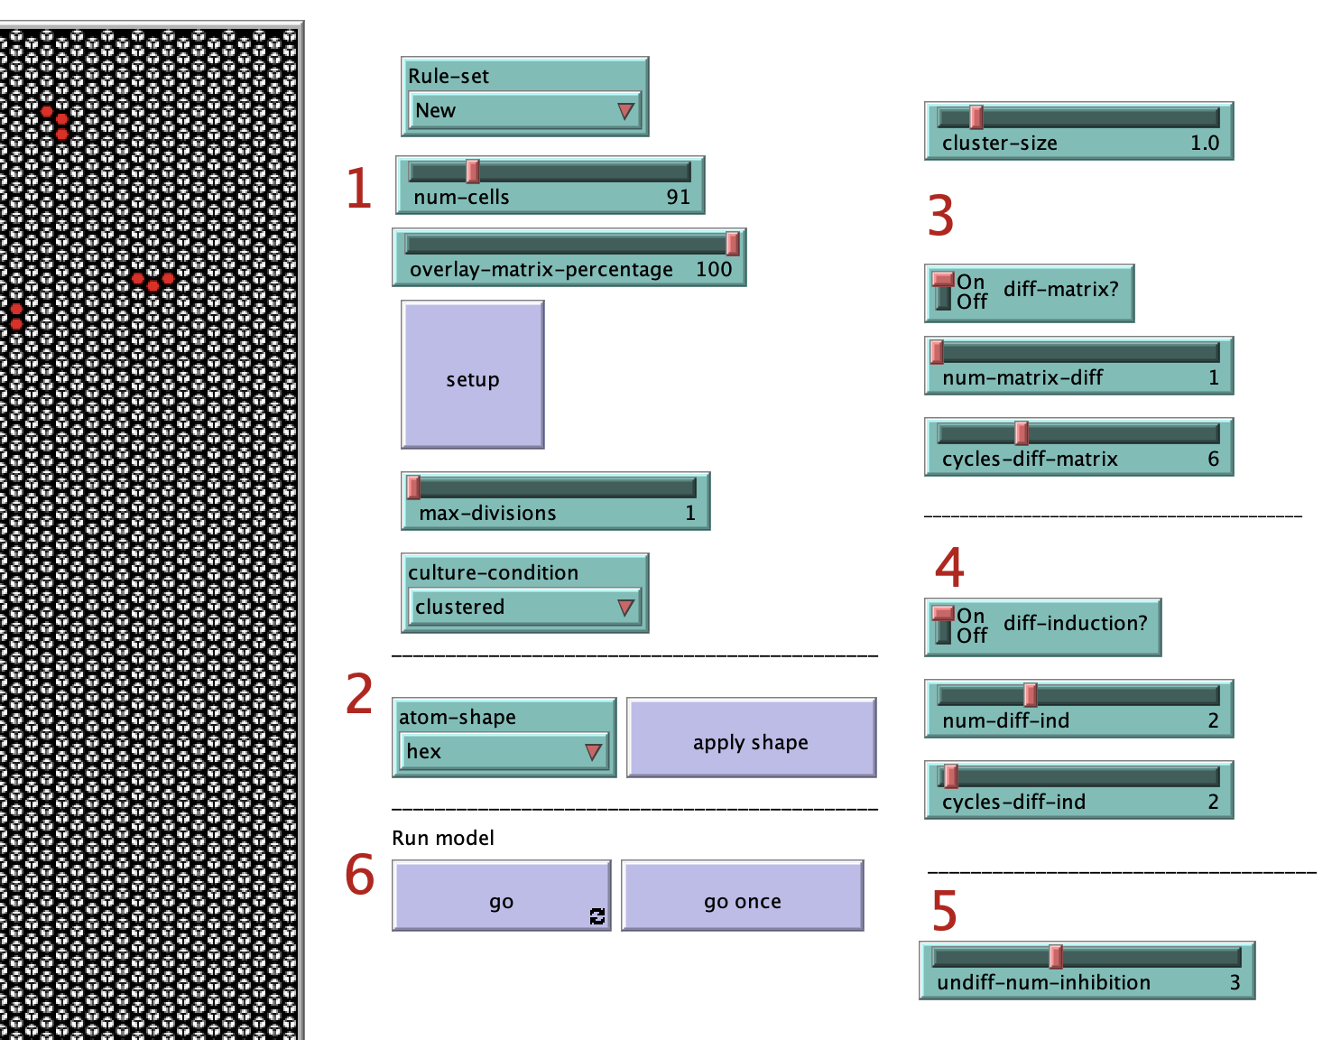
Model Design: Setup and Schedule

Slide 9
Model Design: STEP

Slide 10
Model Calibration
Cyst characteristics
What rules lead to the formation of rounded cysts?
What rules lead to the formation of correct apico-basal polarity?
Differentiation
What rules lead to differentiation at low plating densities and retention of pluripotency at high plating densities?

Slide 11
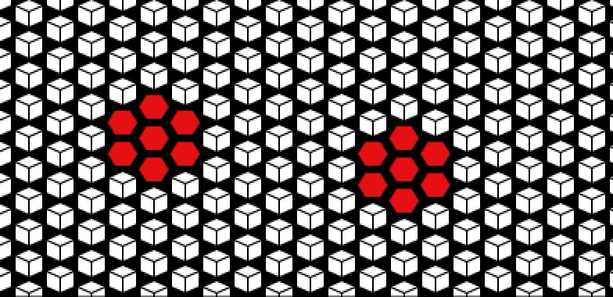
Model Run

Slide 12
Parameter Sweep
Parameter | Range
Initial Cell Number | 10 – 100
Cluster Size | 1, 1.5, 2.5
Max. Divisions | 1 – 2
Matrix Contact for Diff. | 1 – 5
Cycles Matrix Contact | 1 – 10
Contacts for Induction | 1 – 5
Cycles for Induction | 1 – 10
Pluripotent Neigh. Inhibition | 1– 5
From 240 runs, only 74 had parameter combinations that led to successful morphogenesis, specifically differentiation at low plating densities

Slide 13
Next steps and Outstanding Questions
Modify model to obtain retention of pluripotency at high plating densities
Inform and validate model with in vitro experiments
Important observations to inform the model:
Is there a relationship between polarity and proliferation?
Is there a relationship between differentiation and proliferation?
Does a cell’s receptivity to cues from the local environment depend on its state?

